Slide 1
Data Migration

Slide 2
AGENDA
What is Data Migration
Why Data Migration?
Determine The Order Of Migration
Data Load Considerations
Data Migration Process
Tools & utilities
Dataloader and Data Import Wizard
Data Loader.io
Workbench

Slide 3
Introduction
Data migration is the process of selecting, preparing, extracting, and transforming data and permanently transferring it from one system to another. ​
​It is a process of transporting data between computers, storage devices or formats. It is a key consideration for any system implementation, upgrade or consolidation.

Slide 4
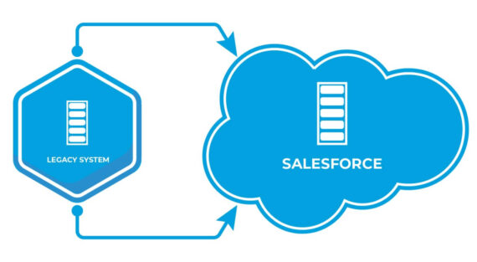
Why Migrate Data?
Salesforce data migration is the very first thing you must do before go-live in order to bring all the existing data from your legacy system into the Salesforce Cloud without losing any of it.
Migration is a one-time activity; once the data is loaded into the Salesforce org, the migration task is complete.
Typically data migration occurs during an upgrade of existing system to a completely new system.

Slide 5
Why Migrate Data?
It is very important to avoid any kind of mistake during Data migration that could cascade into having to do the whole process again or even risk jeopardizing customers’ sensitive data.
Before Migration, ensure:
Identify required fields
List optional & system-generated fields
Capture Legacy IDs for reference
Define business rules & validations

Slide 6
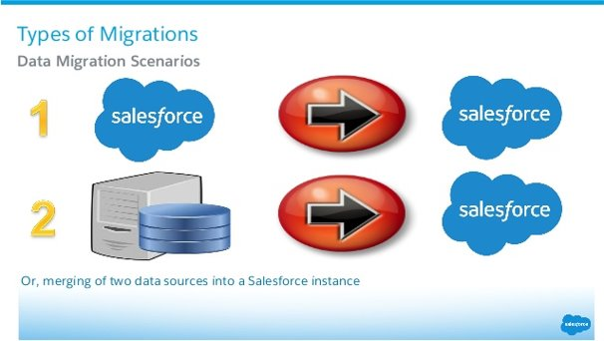
Types Of Data Migration

Slide 7
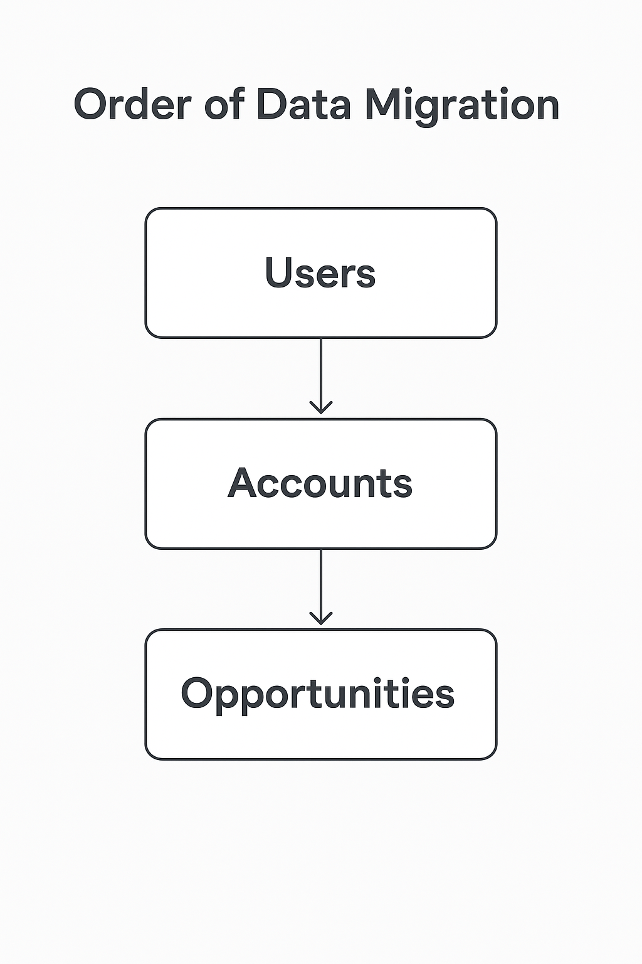
Determine The Order Of Migration
In Salesforce, relationships that exist between objects and dependencies dictate the order of migration. For example, all accounts have owners, and opportunities are associated with an account. In this case, the order would be to

Slide 8
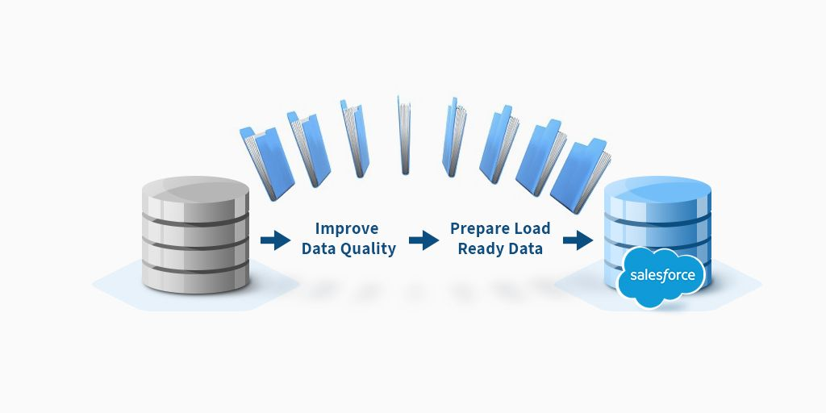
Determine The Order Of Migration

Slide 9
Data Load Considerations
Data Preparation
Standardize data
Clean & validate
De-duplicate records
Improve Load Performance
Use Bulk API for large data volumes
Disable unnecessary triggers, workflows & validations during load
Turn off email notifications

Slide 10
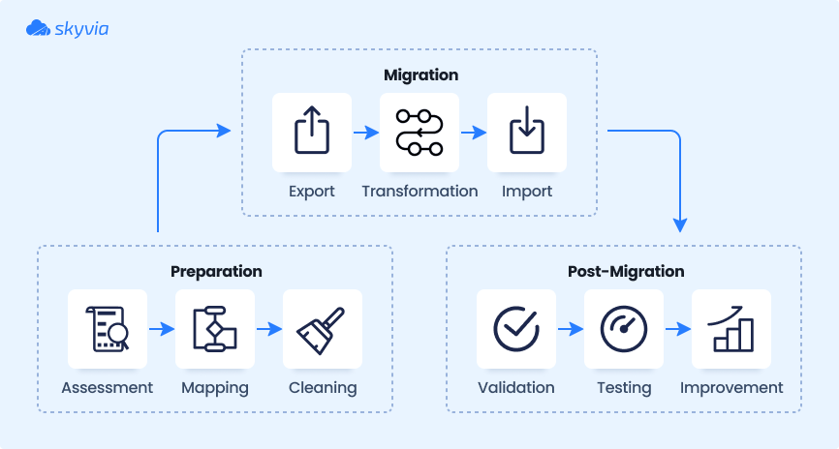
Data Load Considerations

Slide 11
Data Migration Process
Design / Plan
Identify data sources
Determine what to migrate
Estimate record volumes & choose tool
Extract
Pull data from source systems
Transform
Modify data formats & types
Cleanse & de-duplicate

Slide 12
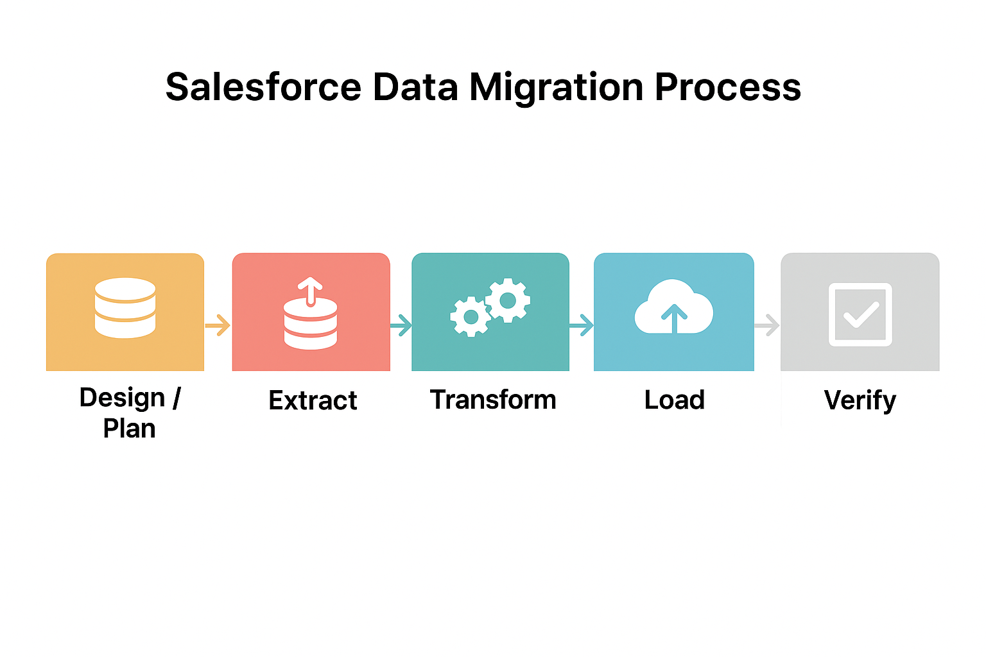
Data Migration Process
4. Load
Import into Salesforce
Use tools (Data Loader, SSIS, Scribe, etc.)
5. Verify
Compare record counts
Spot check records
Run test migration during UAT

Slide 13
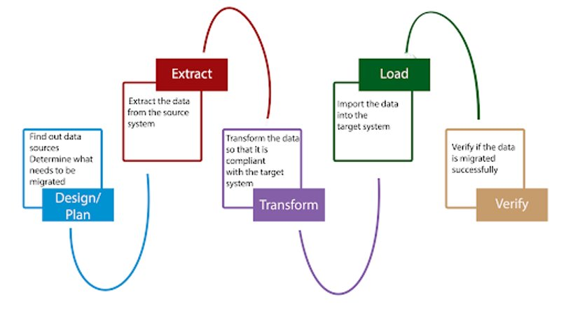
Data Migration Process

Slide 14
Data Migration Tools
Dataloader
Data Loader is a client application for bulk data import and export in Salesforce.
Designed for large data volumes (up to 5 million records).
Supports Insert, Update, Upsert, Delete, and Export operations.
Data Loader reads, extracts, and loads data from comma-separated values (CSV) files
Best for complex migrations, Provide detailed success and error log files in CSV format.

Slide 15
Data Migration Tools
Data Import Wizard
The Data Import Wizard is a built-in Salesforce tool used for importing small to medium volumes of data.
Best suited for simple imports (up to 50,000 records).
Provides an easy, step-by-step interface – no coding or external tools required.
Supports both standard objects (Leads, Accounts, Contacts, Campaign Members, Solutions) and custom objects.
Useful for first-time data loading, quick updates, or small migration tasks.

Slide 16
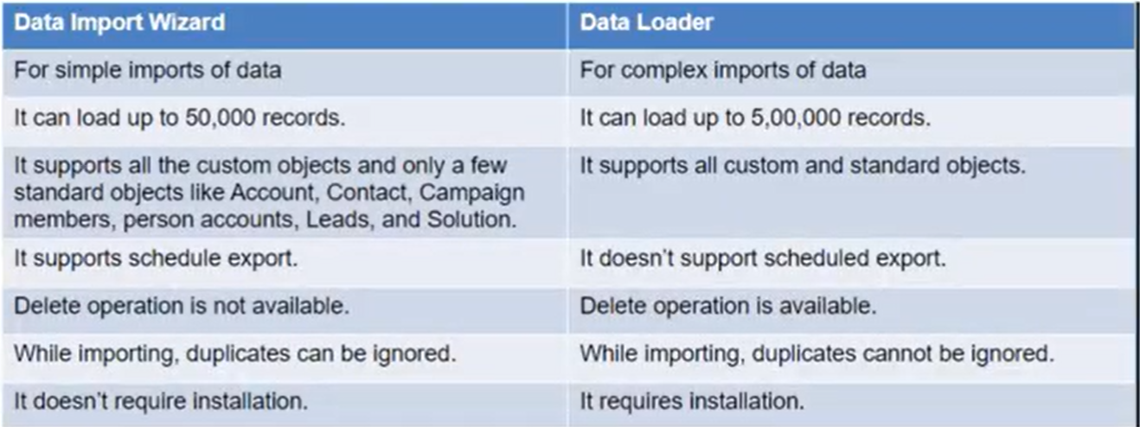
Data Import Wizard vs Data Loader

Slide 17
Data Migration Tools
Dataloader.io
Dataloader.io is simple, free, no download required the app for Salesforce.
100% cloud solution to quickly import, export and delete data in Salesforce.com
Dataloader.io is powered by CloudHub, an integration platform as a service from MuleSoft.
Need to connect your ERP, Marketing Automation or Sales Process Management app to Salesforce? You can build, deploy and manage your integrations easily from the cloud using CloudHub.

Slide 18
Data Migration Tools
Workbench
Workbench is a web-based tool for Salesforce administrators and developers.
Used for data migration, SOQL queries, testing APIs, and troubleshooting.
Supports Insert, Update, Upsert, Delete, Undelete, and Export operations.
Can handle large data volumes (similar to Data Loader).
Runs in browser – no installation required.
Useful for ad-hoc data tasks, API testing, and debugging integrations.

Slide 19
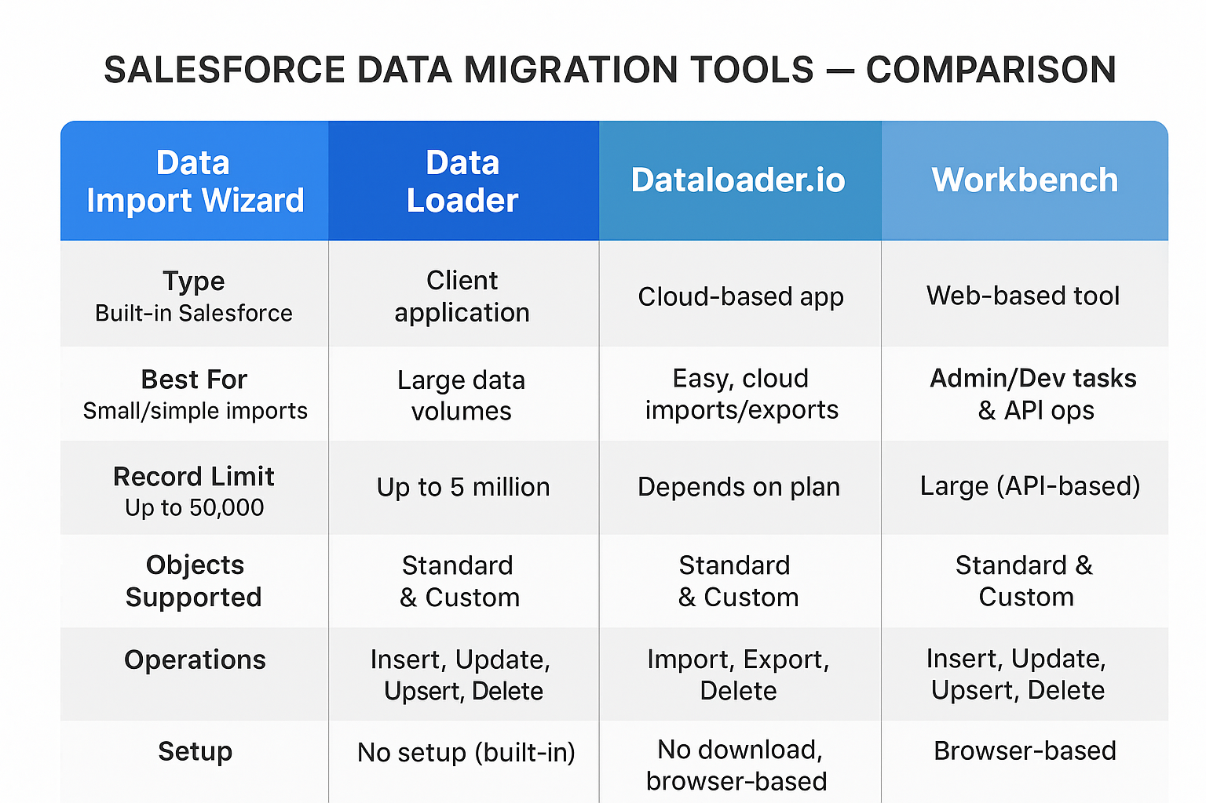
Data Migration Tools

Slide 20
Thanks
Any Questions ?

